Slide 1
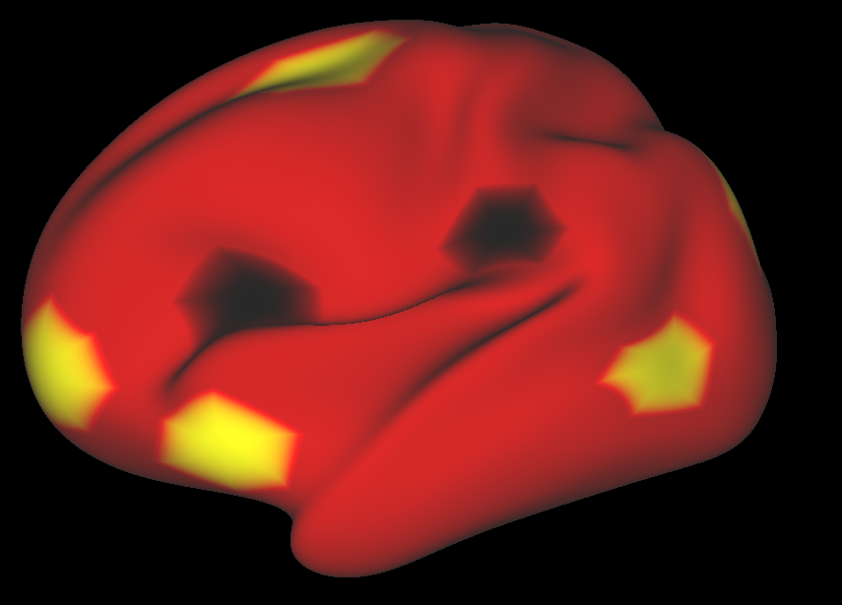
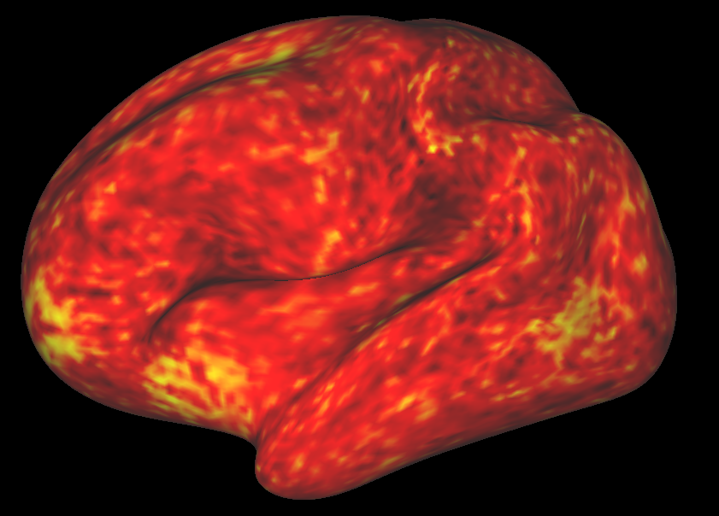

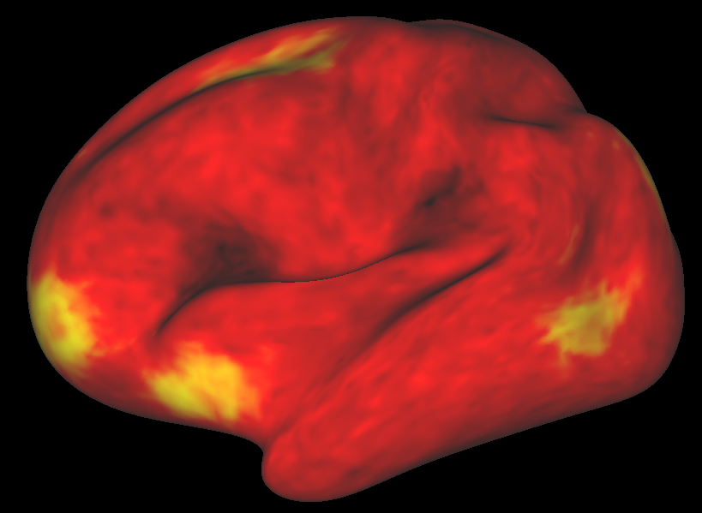
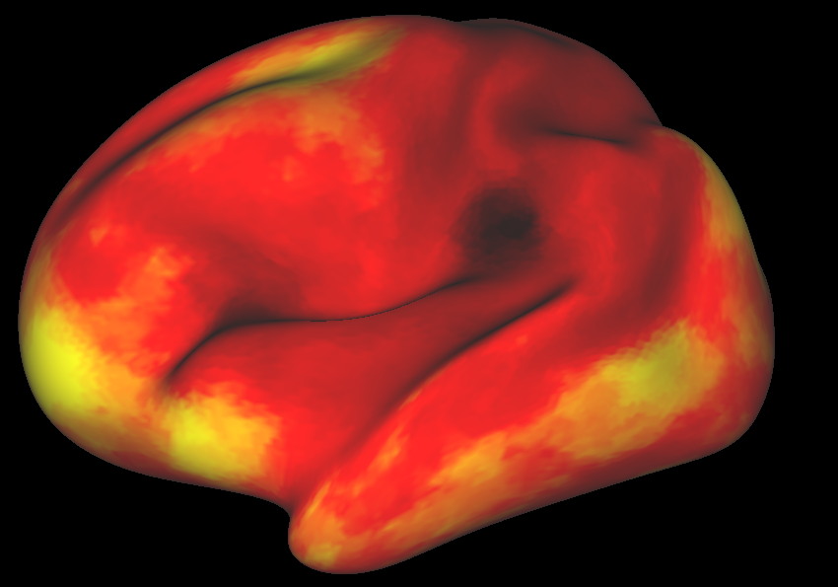
Truth
Mean ASL
projected (a.u.)
80
CBF
40
BASIL projected
SVB hybrid

Slide 2
Ground truth
CBF activation
B
D (not shown)
G
80
F
A
E
CBF
C
40

Slide 3
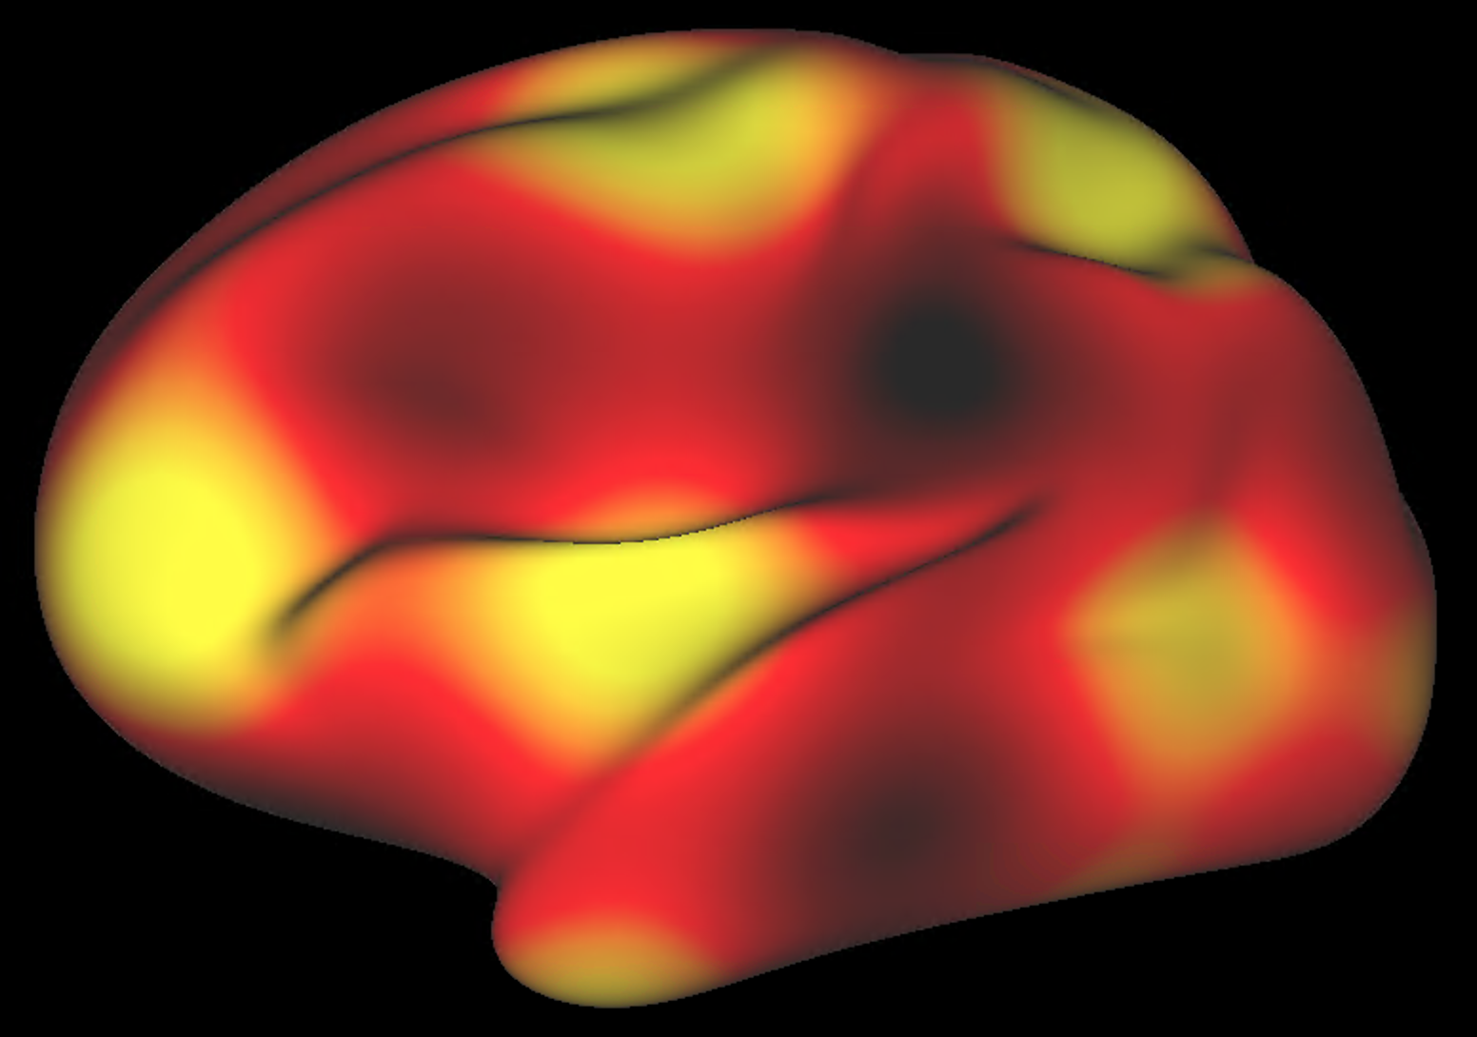
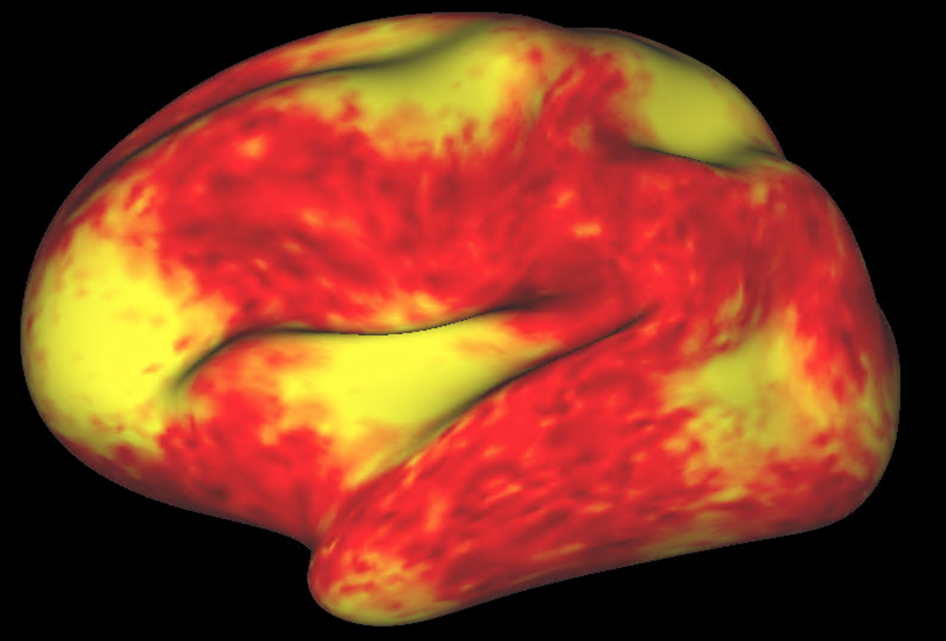
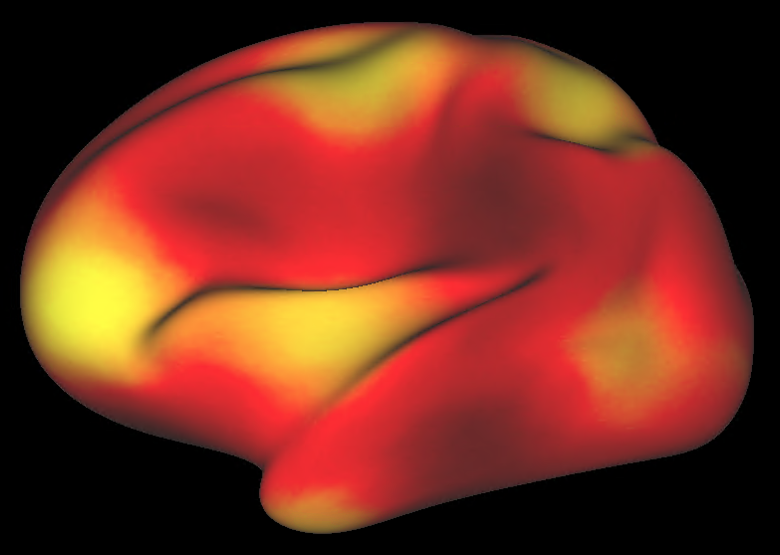
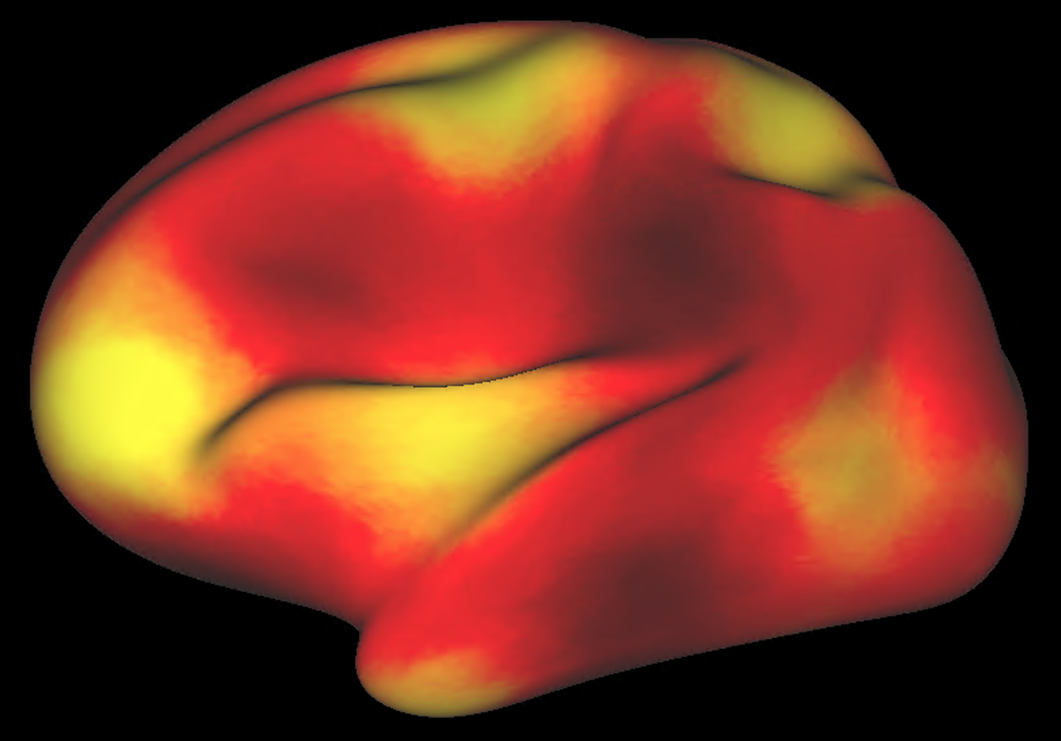
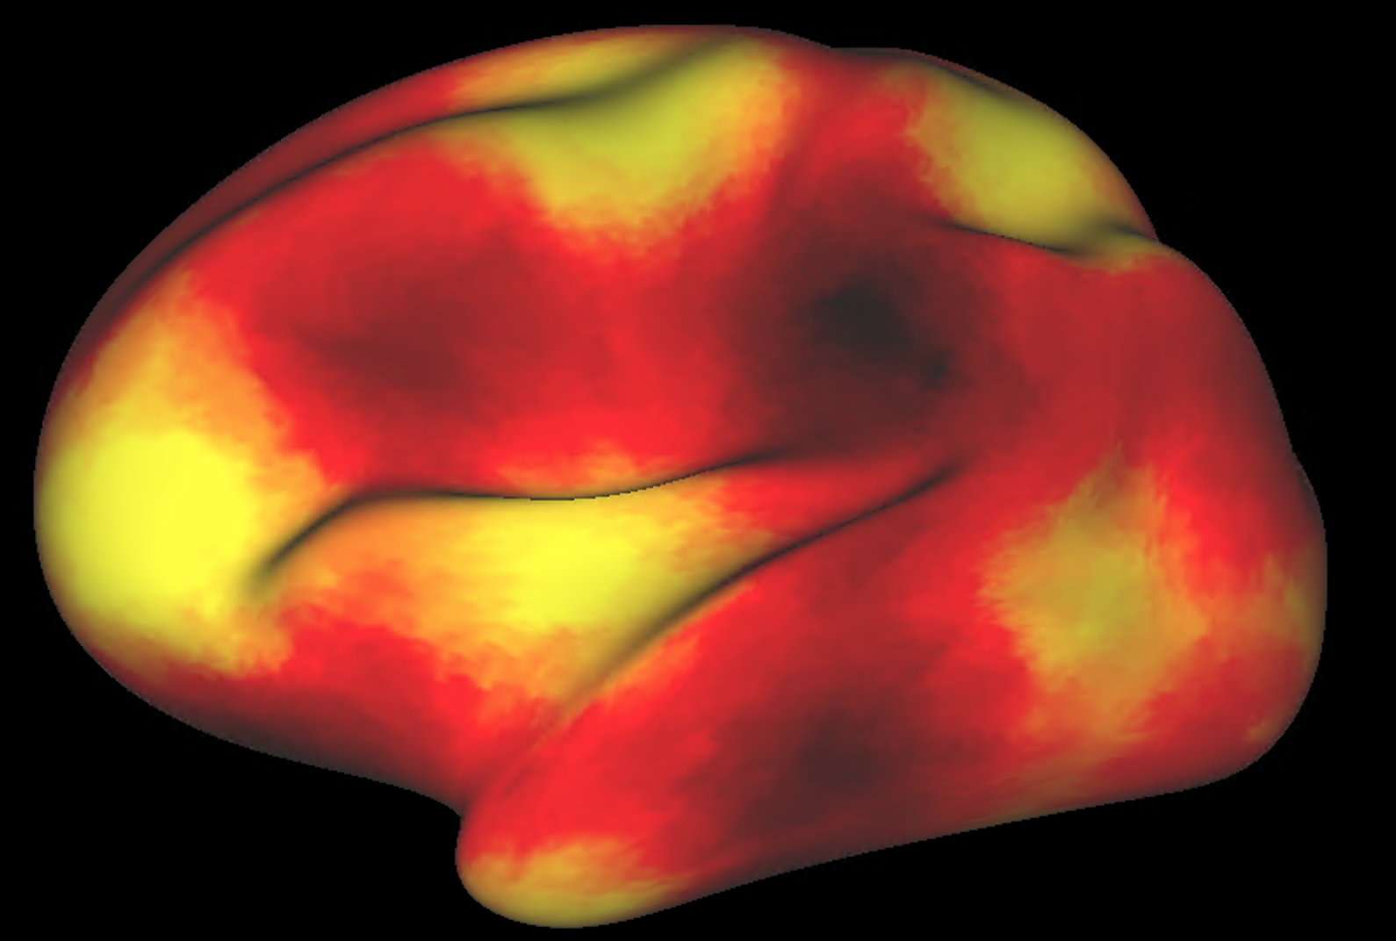
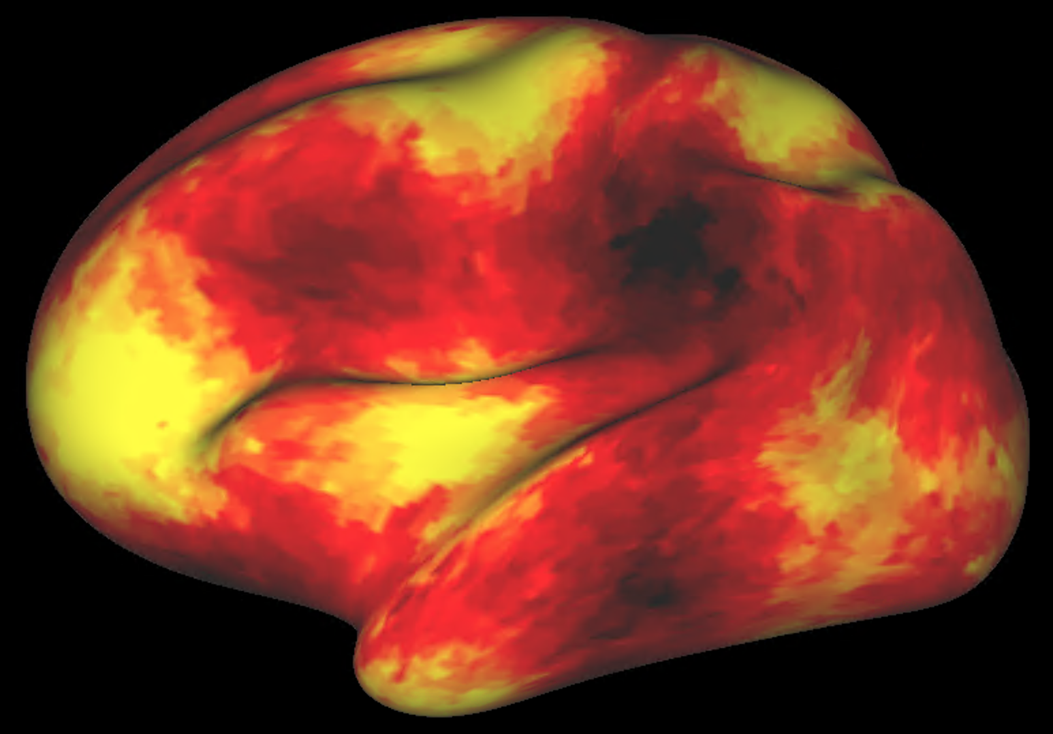




Truth
*
Joint Laplacian †
Split, $β$ = 1
Split, $β$ = 10
Split, $β$ = 100
Split, $β$ = 1000
80
CBF
40

Slide 4
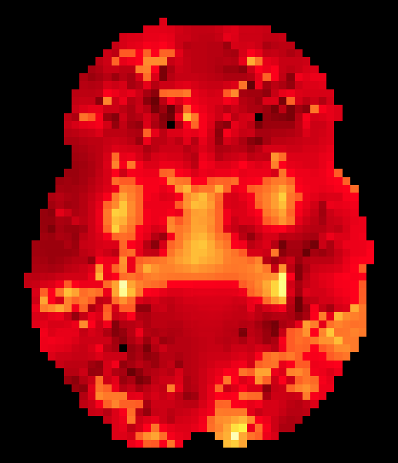
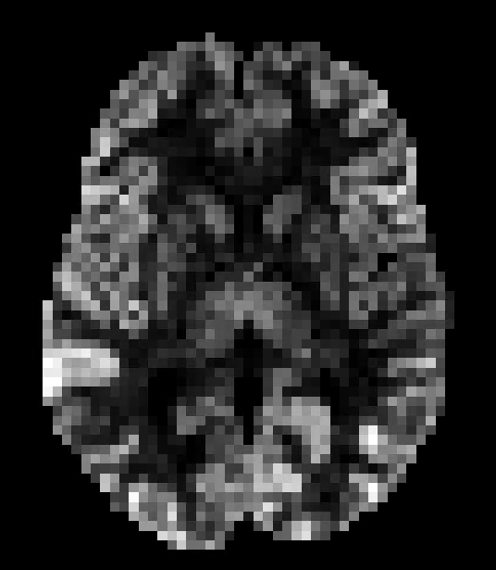
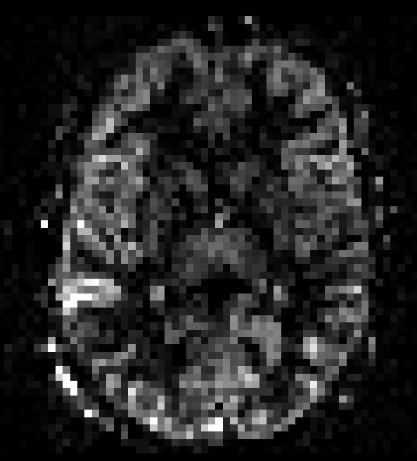
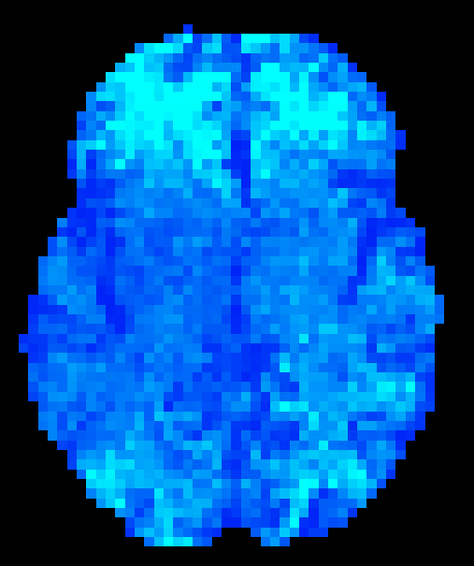
cortex
subcortex
reconstruction
Hybrid space parameter
estimates
Model reconstruction (projection to volume)
ASL data
Parameter latent loss
wrt. priors
Reconstruction loss
wrt. data
Estimate noise properties
noise variance
Noise latent loss
wrt. priors
Free energy
Update parameters in direction of gradient descent

Slide 5
80
CBF
40

Slide 6
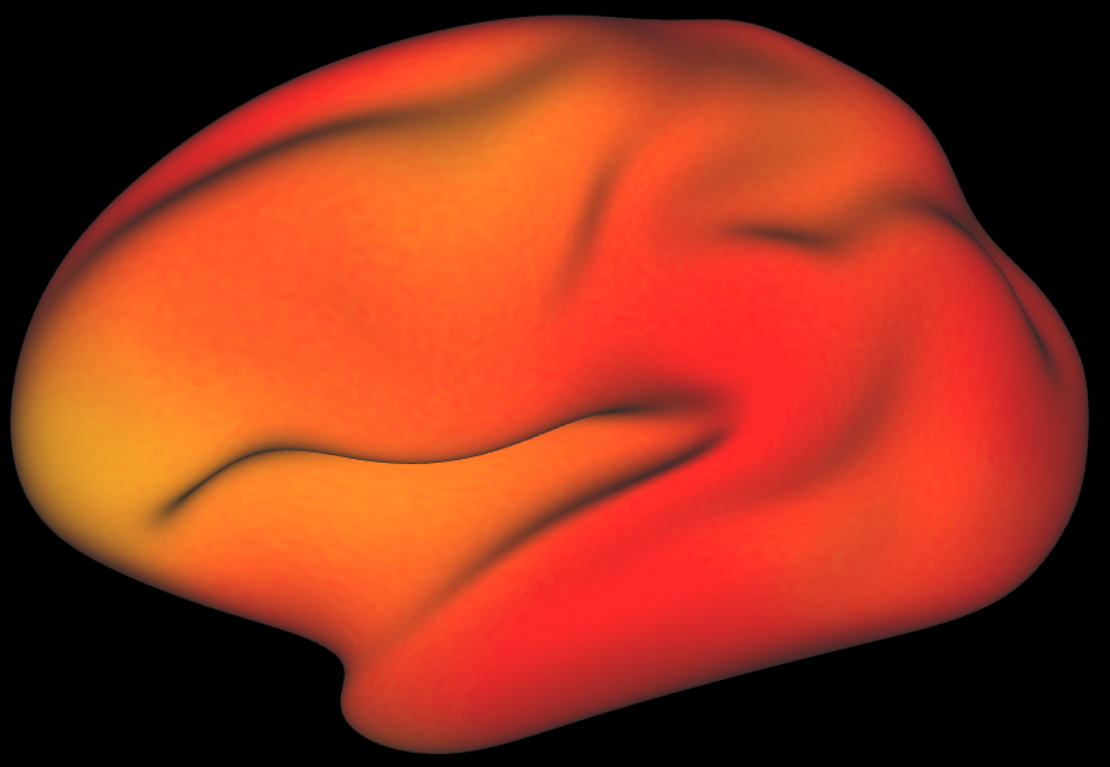
B
80
CBF
A
E
40
C

